Slide 1
CSE 303
Lecture 19
Version control and Subversion (svn)
slides created by Marty Stepp
http://www.cs.washington.edu/303/

Slide 2
Working in teams
  Whose computer stores the "official" copy of the project?
    Can we store the project files in a neutral "official" location?
  Will we be able to read/write each other's changes?
    Do we have the right file permissions?
  What happens if we both try to edit the same file?
  What happens if we make a mistake and corrupt an important file?
    Is there a way to keep backups of our project files?
  How do I know what code each teammate is working on?

Slide 3
Recall: Groups and users
setting groups on files: chgrp group filename
  chgrp -R cse303k * (set group of all to cse303k)
permission codes: chmod who(+-)what filename
  chmod -R g+rwX * (group can read/write all)
command | description
chmod | change permissions for a file
umask | set default permissions for new files
groups | list the groups to which a user belongs
chgrp | change the group associated with a file

Slide 4
Version control
version control system: Software that tracks and manages changes to a set of source code files and resources.
  examples: CVS, Subversion (SVN), Git, Monotone, BitKeeper, Perforce
helps teams to work together on code projects
  a shared copy of all code files that all users can access
  keeps current versions of all files, and backups of past versions
  can see what files others have modified and view the changes
  manages conflicts when multiple users modify the same file
  not particular to source code; can be used for papers, photos, etc.
    but often works best with plain text/code files

Slide 5
Repositories
repository: Central location storing a copy of all files.
  check in: adding a new file to the repository
  check out: downloading a file from the repo to edit it
    you don't edit files directly in the repo; you edit a local working copy
    once finished, the user checks in a new version of the file
  commit: checking in a new version of a file(s) that were checked out
  revert: undoing any changes to a file(s) that were checked out
  update: downloading the latest versions of all files that have been recently committed by other users

Slide 6

Subversion
Subversion: created to repair problems with older CVS system
  supports folders, better renaming, atomic commits, good branching
  currently the most popular free open-source version control system
installing in Ubuntu:
  $ sudo apt-get install subversion
creating a repository:
  $ svnadmin create path
command | description
svnadmin | make administrative changes to an SVN repository
svn | interact with an SVN repository

Slide 7
SVN commands
command | description
svn add files | schedule files to be added at next commit
svn ci [files] | commit / check in changed files
svn co files | check out
svn help [command] | get help info about a particular command
svn import directory | adds a directory into repo as a project
svn merge source path | merge changes
svn revert files | restore local copy to repo's version
svn resolve source path | resolve merging conflicts
svn update [files] | update local copy to latest version
others: blame, changelist, cleanup, diff, export, ls/mv/rm/mkdir, lock/unlock, log, propset

Slide 8
Setting up a repo
on attu, create the overall repository:
  $ svnadmin create path
from attu, add initial files into the repo (optional):
  $ svn import projectname foldername
give the repo read/write permissions to your cse303 group
  $ chgrp -R mycse303group repofoldername
  $ chmod -R g+rwX,o-rwx repofoldername

Slide 9
Adding files to a repo
on your computer, set up a local copy of the repo
  $ svn co svn+ssh://attu.cs.washington.edu/foldername
  or, if you're setting up your local copy on attu as well:
  $ svn co file:///homes/iws/username/foldername
  after checkout, your local copy "remembers" where the repo is
now copy your own files into the repo's folder and add them:
  $ svn add filename
  common error: people forget to add files (won't compile for others)
added files are not really sent to server until commit
  $ svn ci filename -m "checkin message"
  put source code and resources into repo (no .o files, executables)

Slide 10
Committing changes
updating (to retrieve any changes others have made):
  $ svn update
examining your changes before commit:
  $ svn status
  $ svn diff filename
  $ svn revert filename
committing your changes to the server:
  $ svn ci -m "added O(1) sorting feature"

Slide 11
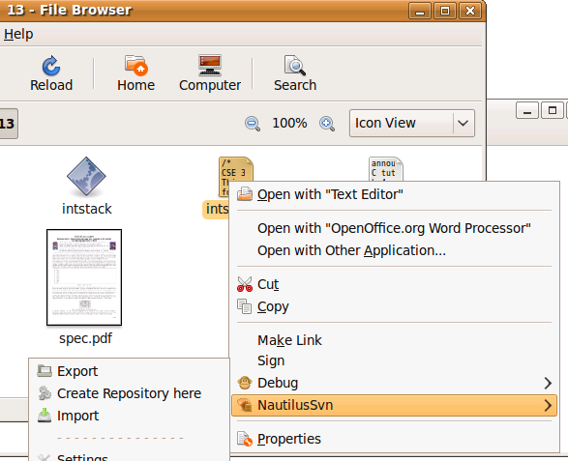
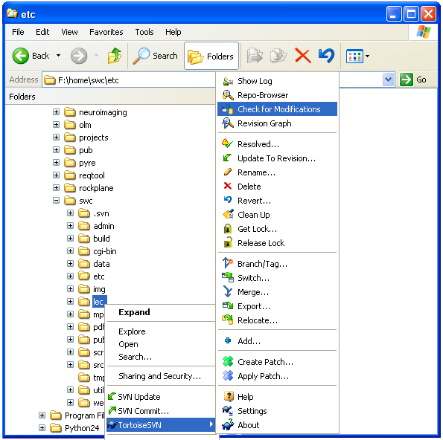
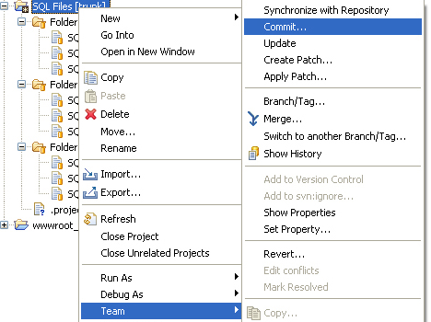
Shell/IDE integration
Linux:
NautilusSVN
Windows:
TortoiseSVN
Eclipse:
Subclipse

Slide 12
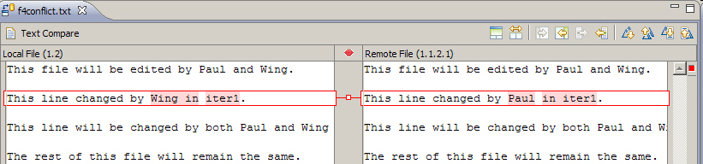
Merging and conflicts
merge: Two sets of changes applied at same time to same files
  happens when two users check out same file(s), both change it, and:
    both commit, or
    one changes it and commits; the other changes it and does an update
conflict: when the system is unable to reconcile merged changes
  resolve: user intervention to repair a conflict. Possible ways:
    combining the changes manually in some way
    selecting one change in favor of the other
    reverting both changes (less likely)

Slide 13
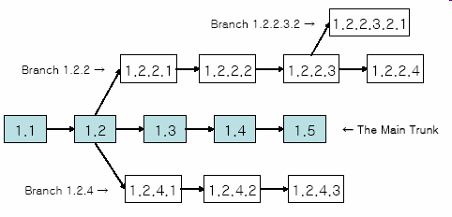
Branches
branch (fork): A second copy of the files in a repository
  the two copies may be developed in different ways independently
  given its own version number in the version control system
  eventually be merged
  trunk (mainline, baseline): the main code copy, not part of any fork

